Slide 1
List
Python Class #5
HEHology

Slide 2
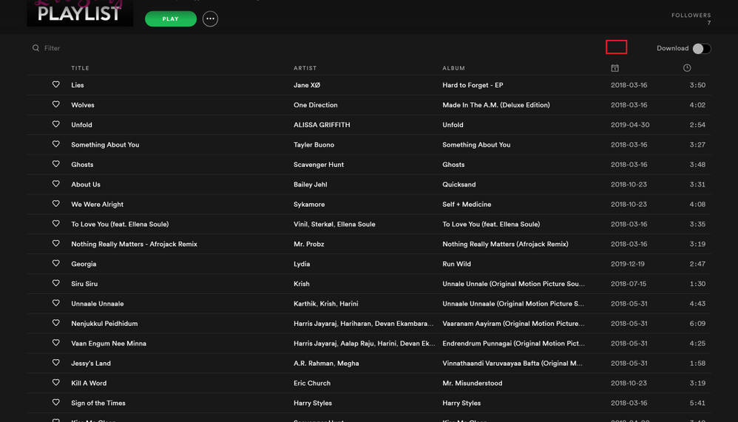

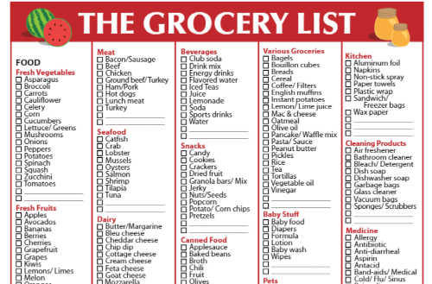

What is a list?
Collection of items
list = []
Playlist
Checklist
Checklist
HEHology

Slide 3
Types of lists?
int list
list = [0,1,2,3,4,5]
string list
Str_list = ['hi','my','name','is','cici']
float list
Test_scores = [66,99.5,100,0,55.3]
boolean list
bools = [True, False, False, True]
HEHology

Slide 4
Why use lists?
To store a collection of values
CRUD
Create
Read
Update
Delete
HEHology

Slide 5
C is for Create
append()
To add values to the end of the list
list.append(False)
copy()
To clone a list
list.copy(cloneMe)
HEHology

Slide 6
R is for Read
len()
To get the number of objects in the list
print(len(list))
count()
To get the number of value
print(list.count('a'))
index()
Gets the index of the first item with the specified value
print(list.index('a'))
HEHology

Slide 7
U is for Update
reverse()
Reverses the order of the list
print(list.reverse())
sort()
Sorts the list in ascending order (default)
list.sort()
list.sort(reverse=True)
extend()
Adds a list to the end of the list
list.extend(prices)
HEHology

Slide 8
D is for Delete
clear()
To empty the entire list
list.clear()
remove()
Removes the first item with the specified value
list.remove('hi')
HEHology

Slide 9

Thanks!
Any questions?
HEHology

